Slide 1
Depreciation

Slide 2
What is Depreciation?
Depreciation: Reduction in the value of an asset over a period of time.

Slide 3
Classification Of Depreciation
Physical Depreciation
Functional Depreciation
Physical Depreciation: Depreciation resulting in physical impairment of an asset.
E.g. The causes may be due to deterioration, wear & tear.
Functional Depreciation: It results not only from deterioration (decline) in the assets ability but from a change in the demand for the services it can render.
E.g. Obsolescence resulting from the discovery of another asset that is sufficiently superior than existing one.

Slide 4
Methods of depreciation
There are several accounting methods that are used to determine an asset’s depreciation expense over the period of its useful life.
  Straight Line Method
  Declining Balance Method (DBM)
  Double Declining Balance Method(DDBM)

Slide 5
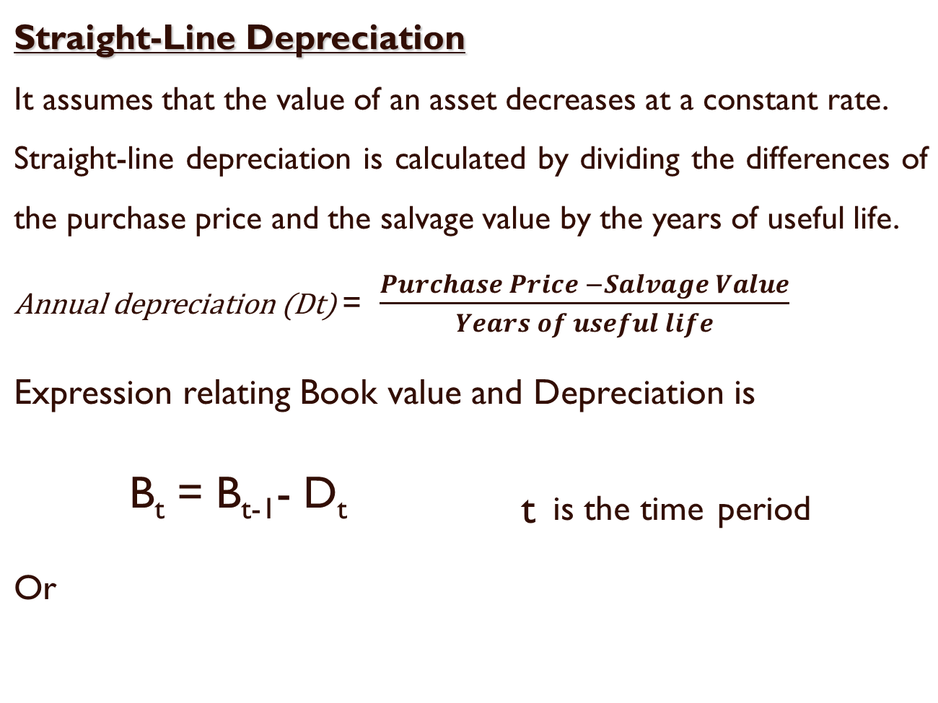
Methods of depreciation
For an asset with an estimated life of n years the depreciation rate by straight line method will be 1/n .
B_{t} = P-t(D_{t})

Slide 6
Straight-Line Depreciation
A person started a small business and rent an office. He furnished the office with $25,000 worth of office furniture. The useful life of the furniture is 5 years and the salvage value is $5,000. Make a straight-line depreciation schedule showing the depreciation on each year.

Slide 7
Solution:
Step1: calculate Annual depreciation value
Annual Depreciation = ($25,000 - $5,000)/5 = $4,000
This value remains same for all the years. Every year the value of the asset depreciates by $4,000.
Step2: Subtract each value (value before depreciation) by $4,000. (25,000-4000=$21,000). Carry over this value to the next year and repeat the procedure.

Slide 8
Straight-Line Depreciation
Solution:
Annual Depreciation = ($25,000 - $5,000)/5 = $4,000
Year | Value before Depreciation | Depreciation | Value after Depreciation (Book value)
1 | $25,000 | $4,000 | $21,000
2 | $21,000 | $4,000 | $17,000
3 | $17,000 | $4,000 | $13,000
4 | $13,000 | $4,000 | $9,000
5 | $9,000 | $4,000 | $5,000

Slide 9
Straight-Line Depreciation
Example 2: A m/c has a first cost of Rs 3,00,000 & salvage value of Rs 60,000 and a life of 5 years. It is being depreciated according to straight line method. The management is trying to find a replacement at the end of 3 years of its useful life. What market value the management should fetch so that the capital invested in the m/c is fully recovered.

Slide 10
Declining-Balance Method (DBM) Depreciation
This method assumes that an asset decreases in value at a faster rate in the early portion of the service life than in the latter portion of its life.
The depreciation rate (R) is given by
R = 1- [(B_{t} / P)]^{1/t} (In percentage)
P- initial cost ; B – book value ; t- time period
The book value for the year is given by B_{t} = B_{t-1} (1-R)…. ( use this formula If book value of previous year is given)
The book value is given by
B_{t} = (1-R)^{t} P ….. ( use this formula if initial cost is given)
The depreciation charge for any year t is given by
D_{t} = R(1-R)^{t-1} P

Slide 11
Declining-Balance Depreciation
Example 3: An asset costs Rs 5000 now and its salvage value is Rs 1000 with a service life of 5 years. The depreciation rate is 30 % per year. Determine the depreciation charges for 5 years & its book value at the end of the years.

Slide 12
Solution:
Do= 0
D1= RP = 0.3 * 5000 = 1500
D2= R (1-R)P = 0.3(1-0.3)5000 = 1050
D3= 735
D4= 515
D5= 360

Slide 13
Cont’d
Bo = 5000
B1= (1-R)P = (1- 0.3)5000 = 3500
B2 = ( 1-R)^2 * P= (1-0.3)^2 * 5000= 2450
B3= 1715
B4= 1200
B5= 840

Slide 14
Double Declining-Balance Depreciation
Straight-line depreciation uses the same amount of depreciation each year, while double declining-balance depreciation uses the same rate of depreciation each year.

Slide 15
Numerical
A person started a small business and rent an office. He furnished the office with $25,000 worth of office furniture. The useful life of the furniture is 5 years and the salvage value is $5,000. Make a double declining-balance depreciation schedule for the office furniture.

Slide 16
Solution:
Step1: find the annual rate of depreciation
Annual rate of depreciation = 2 / years of useful life(n)… in %.
Annual rate of depreciation = 2/5 = 40%

Slide 17
Step2: To find the depreciation value , multiply this rate by the current value (value before depreciation).
eg: $25,000*0.4= $10,000
Now, subtract the value before depreciation and the depreciation value.
i.e $25,000-10,000=$15,000
Step3: Carry over this value to the next year and repeat the procedure.

Slide 18
Double Declining-Balance Depreciation
Example 4 :
A person started a small business and rent an office. He furnished the office with $25,000 worth of office furniture. The useful life of the furniture is 5 years and the salvage value is $5,000. Make a double declining-balance depreciation schedule for the office furniture.
Solution:
Annual rate of depreciation = 2/5 = 40%
Year | Value before Depreciation | Depreciation | Value after Depreciation
1 | $25,000 | $10,000 | $15,000
2 | $15,000 | $6,000 | $9,000
3 | $9,000 | $3,600 | $5,400
4 | $5,400 | $400 | $5,000
5 | $5,000 | $0 | $5,000
0.4($25,000) = $10,000
The value of $400 must be adjusted so that the value after depreciation does not go below the salvage value.

Slide 19
Depreciation
Double Declining-Balance Depreciation
Example :An asset was purchased 10 years ago for Rs 5,00,000. It is depreciated according to DDB for an estimated life of 20 years. The salvage value is Rs 50,000 . calculate its current book value.

Slide 20
Depreciation
Straight-Line Depreciation
Example 4: You started a small business and rent an office. You furnish the office with $25,000 worth of office furniture. The useful life of the furniture is 7 years and the salvage value is $4,000. Make a straight-line depreciation schedule showing the depreciation you are to expense each year.

Slide 21
Depreciation
Straight-Line Depreciation
Example 4: You started a small business and rent an office. You furnish the office with $25,000 worth of office furniture. The useful life of the furniture is 7 years and the salvage value is $4,000. Make a straight-line depreciation schedule showing the depreciation you are to expense each year.
Annual Depreciation = ($25,000 - $4,000)/7 = $3,000

Slide 22
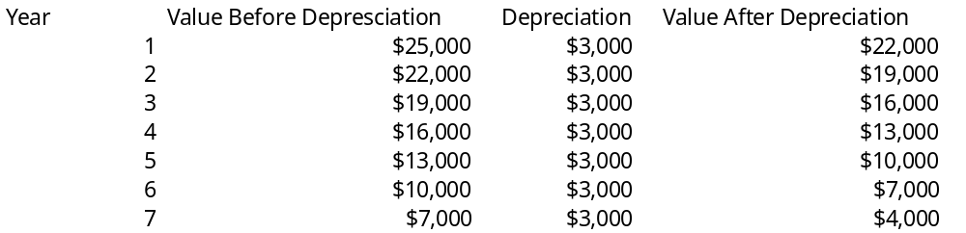
Depreciation
Straight-Line Depreciation

Slide 23
Depreciation
Double Declining-Balance Depreciation
Example 5:
Make a double declining-balance depreciation schedule for the office furniture in example 1 using a useful life of 7 years and a salvage value of $4,000.

Slide 24
Depreciation
Double Declining-Balance Depreciation
Example 5:
Make a double declining-balance depreciation schedule for the office furniture in example 1 using a useful life of 7 years and a salvage value of $4,000.
Annual rate of depreciation = 2/7 = 28.5714285714%

Slide 25
Depreciation
Double Declining-Balance Depreciation
Year | Value Before Depreciation | Depreciation | Value After Depreciation
1 | $25,000 | $7,142.86 | $17,857.14
2 | $17,857.14 | $5,102.04 | $12,755.10
3 | $12,755.10 | $3,644.31 | $9,110.79
4 | $9,110.79 | $2,603.08 | $6,507.71
5 | $6,507.71 | $1,859.35 | $4,648.36
6 | $4,648.36 | $648.36 | $4,000.00
7 | $4,000 | $0 | $4,000

